Slide 1

Depreciation Calculator
Comparison of Straight-Line and Diminishing Balance Methods
Jayesh Malviya
Batch – CX_138

Slide 2

Introduction
Depreciation is systematic reduction of asset value over time.
Important for financial reporting, asset valuation, and tax deduction.
Aim: Compare Straight-Line Method vs Diminishing Balance Method using Excel & answer given problem sets.

Slide 3

Objectives
Calculate depreciation using Straight-Line & Diminishing Balance methods
Prepare 10-year schedules.
Solve Basic / Intermediate / Advanced questions.
Compare both methods with graphs & insights.

Slide 4

Methodology
Inputs:
Asset Cost, Additional Costs, Asset Price, Scrap Value, Life Span, Rate of Depreciation (WDV), and Balance Amount.
Formulas Used:
Asset Price = Asset Cost + Additional Costs
Annual Dep (SLM) = (Asset Price – Scrap Value) ÷ Life Span
Total Dep (SLM) = Annual Dep × Life Span
Dep (DBM) = Opening Book Value × Rate of Depreciation
Conceptual Basis:
SLM: Spreads cost evenly, assuming constant utility over life.
Diminishing Balance Method - Applies higher depreciation in early years, reflecting faster value loss.
Validation: In both methods, Total Dep ≈ Asset Price – Scrap Value; Closing Book Value = Scrap Value.

Slide 5
Basic Problem Statements
Straight Line Method (SLM):
Q1. Calculate the Asset Price
Formula: Asset Price = Asset Cost + Additional Costs
Answer: $5,00,000.00
Q2. What is the depreciation as per straight-line method?
Formula: (Asset Price – Scrap Value) ÷ Life Span
Excel: =SLN(AssetPrice, Scrap, Life)
Answer: $45,000.00
Q3. What is the depreciation percentage for the straight-line method?
Formula: (Annual Depreciation ÷ Asset Price) × 100
Answer: 9.00%

Slide 6
Basic Problem Statements
Q4. What is the total depreciation for its life span?
Formula: Annual Depreciation × Life Span
Should equal Asset Price – Scrap Value
Answer: $4,50,000.00
Q5. Find the depreciated book value after its life span
Formula: Asset Price – Total Depreciation
Should equal Scrap Value
Answer: $50,000.00
Q6. What is the Balance amount?
Balance Amount = Book Value after Life Span
Answer: $0

Slide 7
Basic Problem Statements
Diminishing Balance Method (WDV):
Q1. Calculate the Asset Price
Formula: Asset Price = Asset Cost + Additional Costs
Answer: $5,00,000.00
Q2. Find the rate of depreciation as per diminishing balance method
Excel Formula: =IF(D20="","",1-(D21/D20)^(1/D22))
Answer: 20.57%

Slide 8
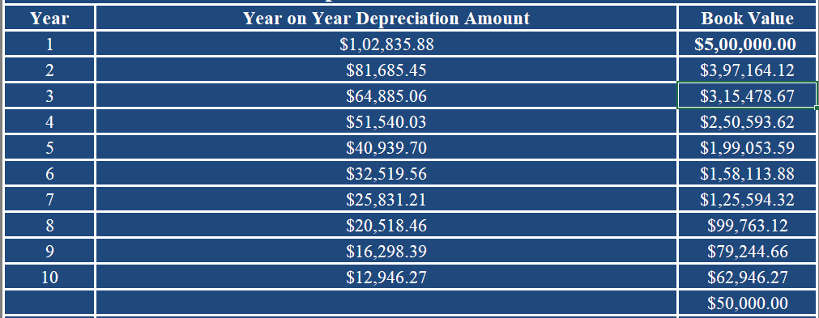
Intermediate Problem Statements
Q1. Book Value for Year 1 & Depreciation for Year 1
Answer: Book Value (Y1) = $5,00,000.00 & Depreciation (Y1) = $1,02,835.88
Q2. Book Value for Year 2 & Depreciation for Year 2
Answer: Book Value (Y2) = $3,97,164.12 & Depreciation (Y2) = $81,685.45
Q3. Book Value for Year 3 & Depreciation for Year 3
Answer: Book Value (Y3) = $3,15,478.67 & Depreciation (Y3) = $64,885.06
Q4. Extend to 10 years

Slide 9
Advanced Problem Statements
Q1) Annual depreciation (Straight-Line)
Answer = $45,000.00 Formula used: =(AssetPrice - Scrap) / Life
Q2) Total depreciation for whole life (Straight-Line)
Answer: = $4,50,000.00 Formula used: = (AssetPrice - Scrap)
Q3) Book value after life (Straight-Line)
Answer: = $50,000.00 Formula used: = AssetPrice - ((AssetPrice - Scrap) / Life) * Life [It should be equal to scrap value]
Q4) Rate of depreciation per year (Diminishing Balance)
Answer = 20.57% Formula used: = 1 - (Scrap / AssetPrice) ^ (1 / Life)

Slide 10
Advanced Problem Statements
Q5) Depreciation in Year 2 (Diminishing Balance)
Answer = $81,685.45 Formula = [Asset price – Dep (Y1)] * diminishing_rate
Q6) Book value at end of Year 4 (Diminishing Balance)
Answer = $2,50,593.62 Formula used: = Book value (Y3) – Depreciation Amount (Y3)
Q7) Total depreciation for whole life (Diminishing Balance)
Answer = $4,37,053.73
Formula used: = Book Value (Y1) – Book Value (Y10)
Q8) Book value after life (Diminishing Balance)
Answer = $50,000.00 Formula used = Scrap Value

Slide 11
Advanced Problem Statements
Q9) Compare total depreciation from Straight Line & diminishing Method. Which is higher?
Answers to show in sheet:
Total Depreciation (SLM) = $4,50,000.00
Total Depreciation (DBM) = $4,50,000.00
Total Depreciation amount is same for both the methods.

Slide 12
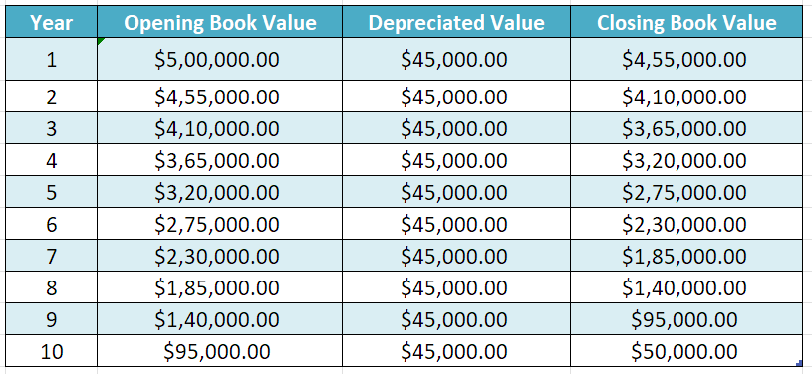
Comparison & Analysis
Straight-line Method

Slide 13
Comparison & Analysis
Diminishing Balance Method

Slide 14
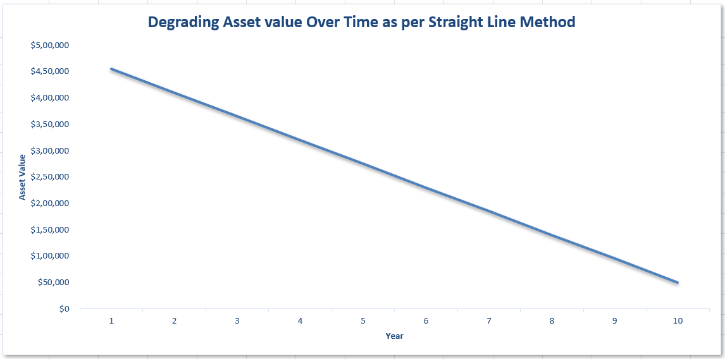
Book/Asset Value vs. Year
Straight-line Method

Slide 15
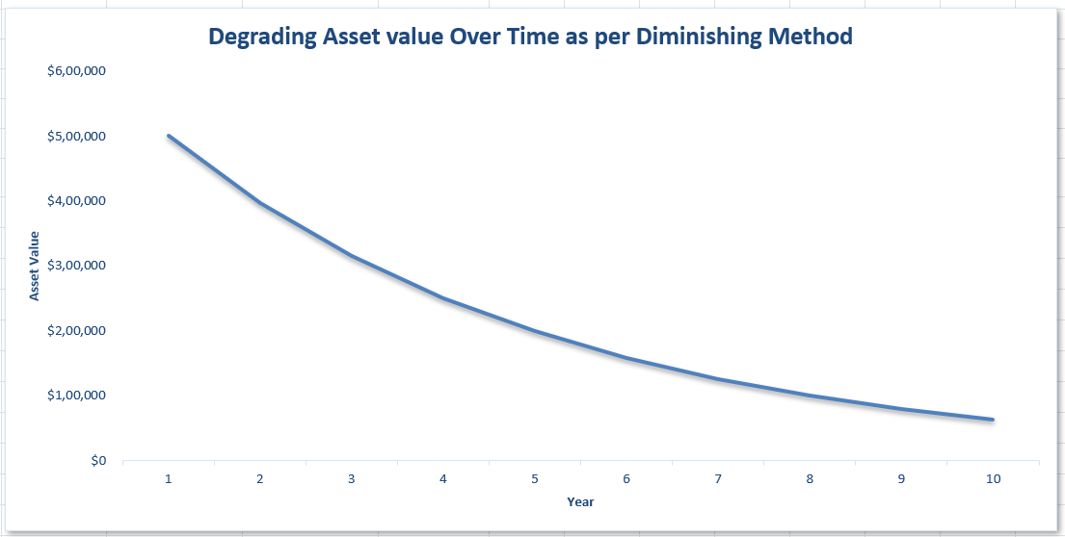
Book/Asset Value vs. Year
Diminishing Balance Method

Slide 16
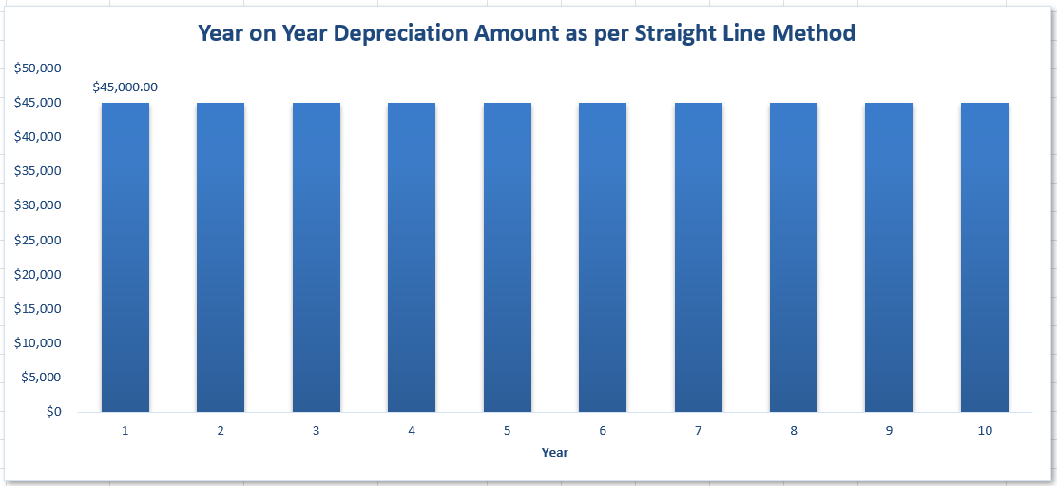
Yearly Depreciation Amount
Straight-line Method

Slide 17
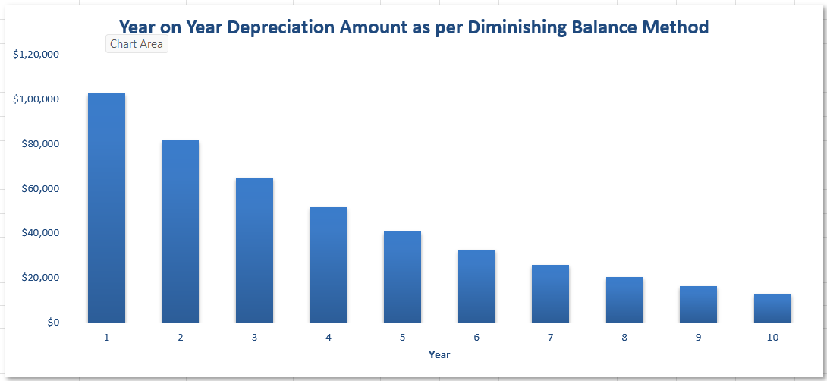
Yearly Depreciation Amount
Diminishing Balance Method

Slide 18
Comparison Insights
Straight-Line Method (SLM):
Depreciation expense remains constant every year, which simplifies planning and reporting.
Ensures stability in profit & loss statements, as expenses are evenly distributed.
Best suited for assets like buildings, furniture, or fixtures that provide a uniform level of benefit over their useful life.
Diminishing Balance Method:
Depreciation is higher in the initial years and gradually reduces over time.
Mirrors the real-world usage pattern of many assets (e.g., machinery, vehicles, technology) that lose efficiency or value quickly in the beginning.
Provides a tax advantage in early years, since higher depreciation lowers taxable profit initially.

Slide 19
Conclusion
Both Straight-Line Method (SLM) and Diminishing Balance Method depreciate the asset by the same total amount (Asset Price − Scrap Value) over its useful life.
The key difference lies in timing:
SLM spreads depreciation evenly, ensuring stability in reporting and budgeting.
Diminishing Balance Method charges more in early years, reflecting faster wear and providing early tax benefits.
The choice of method depends on the asset’s nature:
SLM suits assets with steady utility (e.g., buildings, furniture).
Diminishing Balance Method fits assets that lose value quickly (e.g., machinery, vehicles, technology).

Slide 20
Thank you

